Slide 1
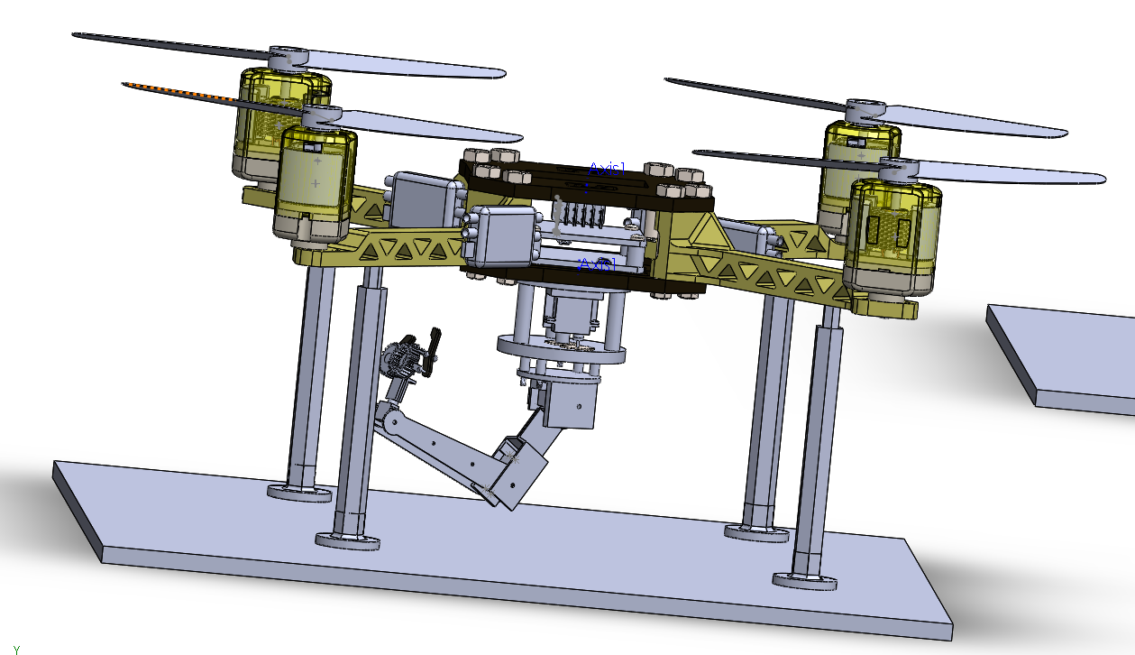
The Reaper
Group Members:
Abdallah Abdallah
Ali Hajjaj
Imad Mostafa
Sara Oud

Slide 2
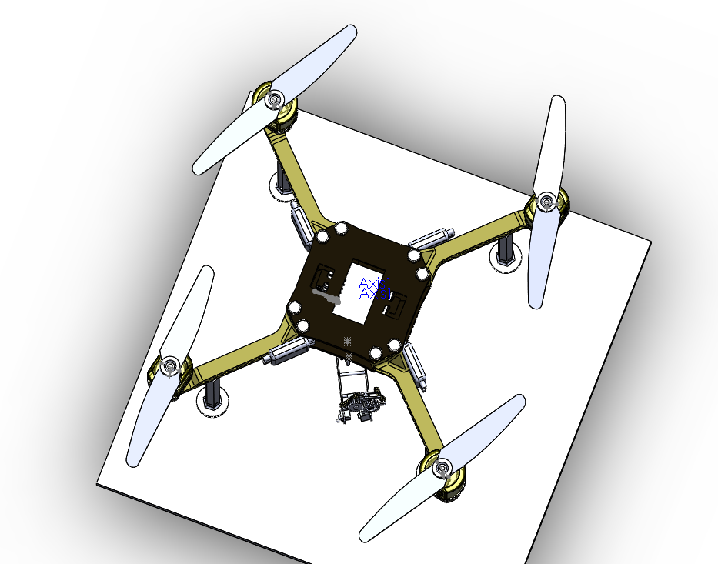
Functionality:

Slide 3
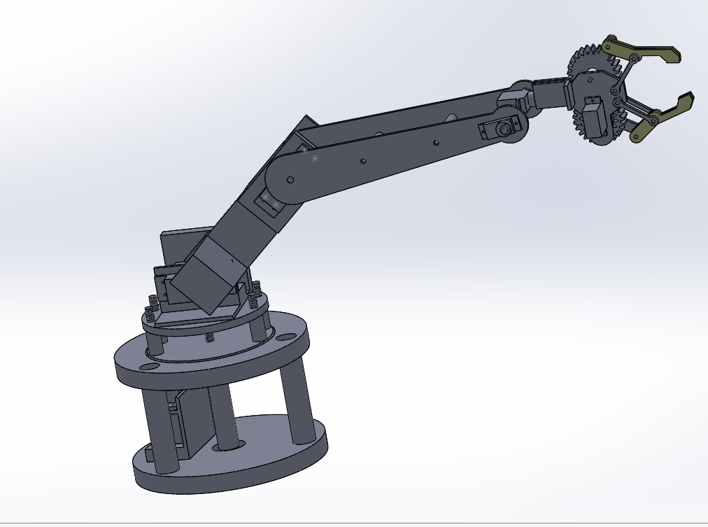
Functionality:
.

Slide 4
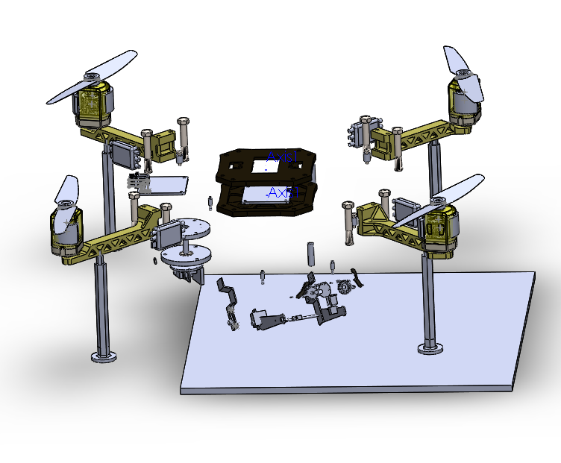
CAD Model :

Slide 5
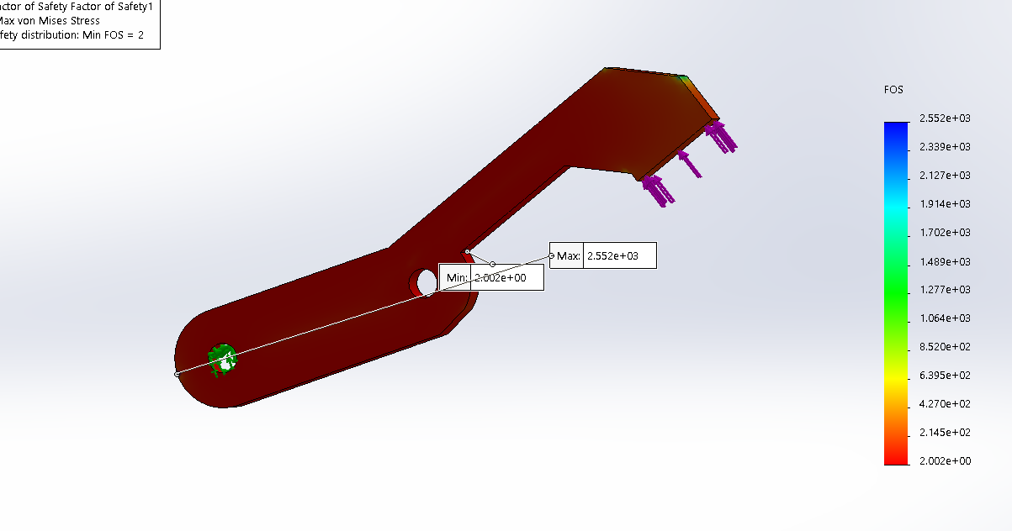
Stress Analysis Plots:

Slide 6
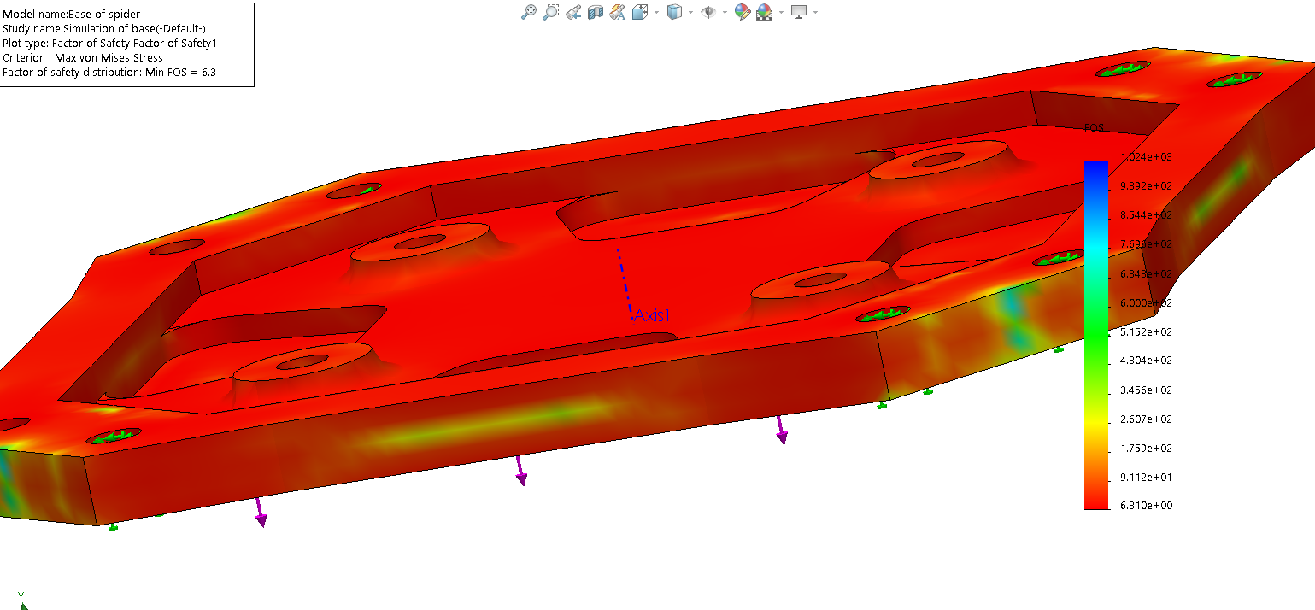
Stress Analysis Plots:

Slide 7
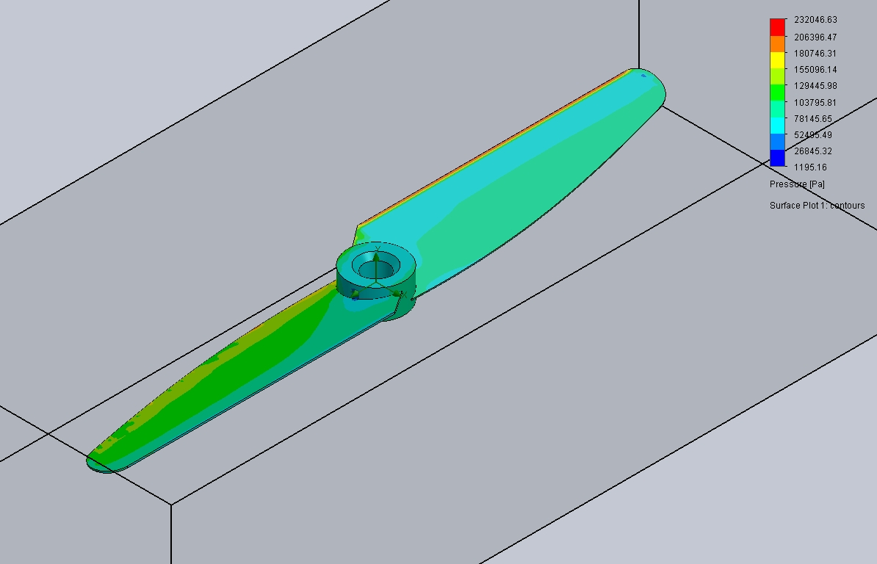
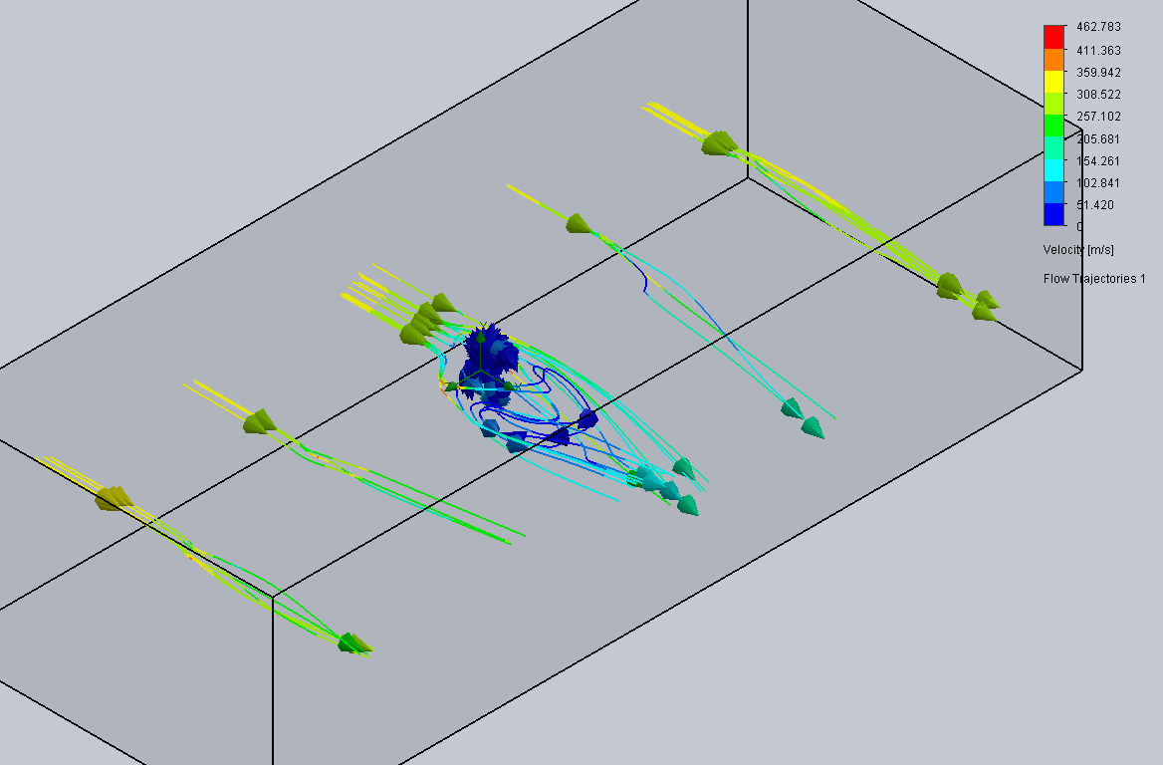
Flow Simulation:

Slide 8
Bill of Materials:
Parts:
Drone assembled by Ali Hajjaj and Imad Mostafa
Robotic arm assembled by Abdallah Abdallah and Sara Oud

Slide 9
References:
https://youtu.be/8BchvQPJsL0
https://youtu.be/Z4vRkZ8kcTU
https://youtu.be/xe56q9L2fvU
https://www.youtube.com/watch?v=8dB3rHustnY

